Slide 1


DEPARTMENT OF COMPUTER SCIENCE ENGINEERING
Project name : TRAFFIC MANAGEMENT SYSTEM
Team name : Proj_224783_Team_2
Team members : 1.Praajeet M R(113321104076)
2.Peddu Venkata Pavan Kumar(113321104074)
3.Pragadesh R(113321104077)
4.Praveen J(113321104078)

Slide 2
Project
Traffic management refers to the practice of controlling and regulating the movement of vehicles and pedestrians on roadways and transportation networks to ensure safety, efficiency, and order. It involves a combination of policies, strategies, and technologies aimed at optimizing the flow of traffic, reducing congestion, and minimizing the risks of accidents and delays. Effective traffic management is crucial in urban areas and along major transportation corridors, where the volume of vehicles and pedestrians can be high and diverse.

Slide 3
AI FOR TRAFFIC MANAGEMENT
Traffic Prediction: AI can analyze real-time data from IoT sensors, cameras, and traffic lights to predict traffic congestion and provide insights to city planners for better traffic management.
Adaptive Traffic Signals: AI algorithms can adjust traffic signal timings based on current traffic conditions, helping to reduce congestion and improve traffic flow in real-time.
Intelligent Routing: AI can provide drivers with dynamic route recommendations by analyzing traffic data from IoT sensors, helping them avoid congested areas and save time.
Incident Detection: AI can quickly identify accidents, road closures, or other incidents by analyzing data from IoT devices, and notify authorities for faster response.
Parking Management: IoT sensors can monitor parking availability, and AI can guide drivers to available parking spots, reducing the time spent searching for parking.

Slide 4
ADS FOR TRAFFIC MANAGEMENT
Adaptive Cruise Control (ACC): ACC uses sensors to maintain a safe following distance between vehicles, automatically adjusting speed to traffic flow. It can help reduce traffic congestion and improve the efficiency of highways.
Lane Keeping Assistance: This feature helps drivers stay within their lanes, reducing lane departures and the likelihood of accidents. It contributes to smoother traffic flow.
Collision Avoidance Systems: ADS can detect obstacles or other vehicles in the vehicle's path and provide warnings or intervene to prevent collisions, helping reduce traffic accidents and traffic jams caused by accidents.

Slide 5
DAC FOR TRAFFIC MANAGEMENT
Access Control Policies: DAC allows traffic management authorities to define dynamic access control policies based on various factors, including real-time traffic conditions, user profiles, vehicle types, and more.
Traffic Flow Optimization: By dynamically adjusting access and traffic routing based on real-time data, DAC can help optimize traffic flow. For example, it can control which vehicles are allowed to enter certain areas or lanes during peak hours.
Dynamic Lane Management: DAC can be used to change lane configurations and access permissions based on traffic conditions. This can involve dynamically opening or closing lanes, such as express lanes or toll lanes, to manage traffic congestion.
Emergency Response: DAC can enable rapid response and coordination in emergencies or critical situations. For instance, it can prioritize access for emergency vehicles and change traffic signals to facilitate their passage.

Slide 6
IOT FOR TRAFFIC MANAGEMENT
Traffic Monitoring: IoT sensors, cameras, and other devices can collect real-time data on traffic conditions, including vehicle flow, speed, and congestion. This data is essential for traffic management and can be used to make informed decisions.
Intelligent Traffic Lights: IoT-enabled traffic lights can dynamically adjust signal timings based on traffic conditions. For example, they can prioritize lanes with heavier traffic to reduce congestion.
Parking Management: IoT sensors in parking spaces can provide information on available parking spots, helping drivers find parking quickly and reducing traffic caused by vehicles searching for parking.
Smart Traffic Signage: IoT-connected digital signs can convey real-time information to drivers, such as road closures, accident alerts, and detour instructions.

Slide 7
CAD FOR TRAFFIC MANAGEMENT
Computer-Aided Design (CAD): CAD software is often used in the planning and design phase of traffic management projects. Engineers and urban planners use CAD software to create detailed, accurate, and precise drawings, maps, and plans for road infrastructure, traffic signals, and other elements of transportation systems. CAD tools help design traffic flow, parking facilities, and road layouts to optimize traffic management.
Computer-Aided Dispatch (CAD): CAD, in this context, refers to Computer-Aided Dispatch systems, which are used by public safety and emergency services, including traffic management. These systems help dispatchers manage and coordinate emergency responses, including those related to traffic incidents such as accidents, road closures, and traffic congestion. CAD systems enable dispatchers to allocate resources efficiently and ensure a rapid response to incidents, thereby contributing to traffic management.

Slide 8
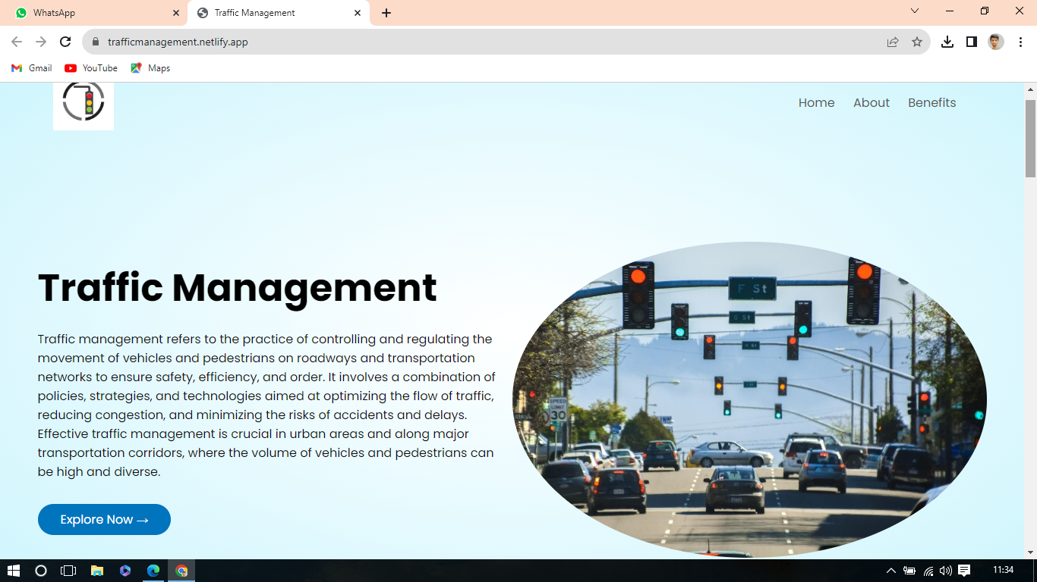
Click here to check our website

Slide 9
CONCLUSION
In conclusion, a well-implemented traffic management system is essential for enhancing road safety, reducing congestion, and improving overall transportation efficiency. Through the use of advanced technology, data analytics, and smart infrastructure, such systems have the potential to transform urban mobility and make our roads safer and more accessible for everyone. However, their success depends on continuous investment, maintenance, and adaptation to the evolving needs of our cities and transportation networks. With a commitment to innovation and collaboration between government authorities, technology providers, and the public, we can create a more sustainable and efficient future for urban transportation.

Slide 10
THANK YOU!

